Slide 1
GAME ENGINE

Slide 2
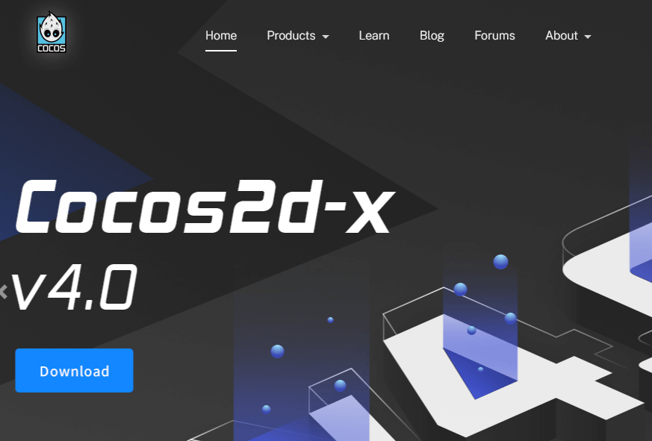
Cocos2d
Cocos2D-x is a package of 2D game development tools, owned by Facebook. As it is a product of Facebook, everything is available in detail about the product. It comes with detailed documentation and has a large support community, and thus anyone can easily read the content, and they can learn the tool. It is a script development, entity-component, and data-driven development tool that is focused on creating content. Developers can develop high-performance games using its powerful suite. It includes an all-in-one extensible editor that simplifies resource management, game debugging, previewing, and multi-platform publishing.

Slide 3
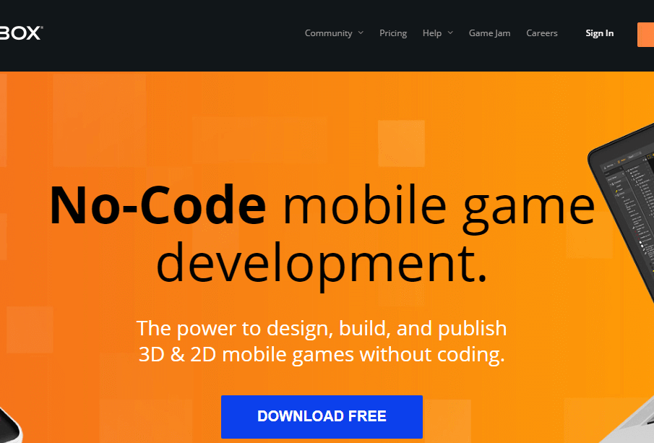
BuildBox
BuildBox can be used to develop games very easily and in a short time. The process of developing games on BuildBox is just selecting the images, importing them, assigning the roles, and your game is ready to be played. There is no need to do coding for developing your gaming app. Changes in the game can be made, and the effect can be checked in real-time using the BuildBox engine. It is a friendly platform for people who are not tech experts.

Slide 4

Titanium
Titanium is a product of a company called Appcelerator that allows you to build mobile apps in JavaScript, and then you can compile it out to native apps for various platforms. The Titanium Game Development engine helps the developer to develop bold, beautiful, and transformative mobile experiences. It is an open and extensible development framework that can be used to create cross-platform games. API Builder (formerly Arrow) combines a robust framework for building APIs with an elastically scalable cloud service for running them.

Slide 5
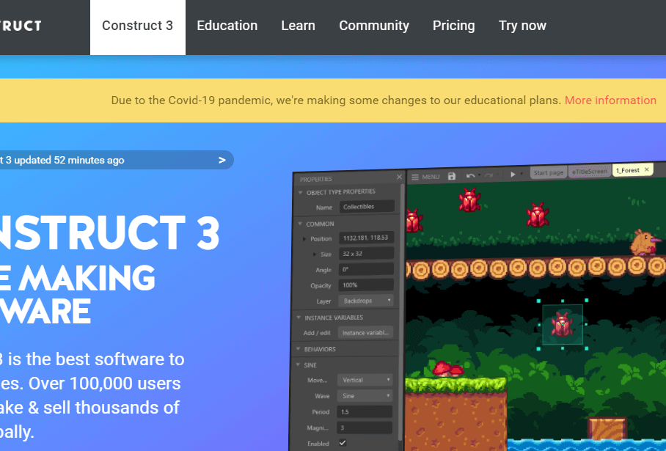
Construct 3
Construct is considered as the perfect game editor for ultra beginners. It is also used in classrooms to teach the students the basics of game development. Construct is created by Scirra company and it is an HTML5 engine that targets non-programmers. Construct uses a virtual scripting system, which makes it even more accessible for beginners. Construct’s block-based system is all about layers and events, and thus it can be used to create logic in your game. Construct also supports JavaScript.

